Slide 1
Global Innovative Quality Solutions

Slide 2
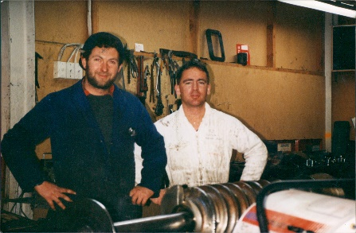
GTech’s History
GTech New Zealand forms after Hutchison Hayes buyout
Quantum range developed
Established in Sydney with Graham Gibbon
Bellmor Establsihed in Belfast NZ
Oil and Gas Market crashes
1989
1994
1996
2003
2009
2010
2016
2021
Bellmor enters decanter & separator market with Hutchison Hayes Partnership
GTech Australia moves to Melbourne
GTech enters USA Oil and Gas Market
Develops Echo-3 range
GTech
diversifies beyond the Oil and Gas Market with the
Echo-4 3 phase decanters

Slide 3
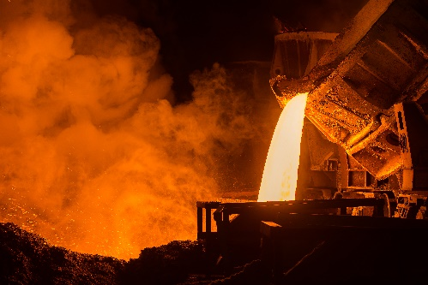
GTech’s Industries and Products
Edible and Inedible Oils
Industrials
Oil and Gas
By-Products
Environmental
Echo Range of 2 and 3 Phase Decanters
Quantum Range of Separators
Turnkey Solutions
Control Panels
Grinders
Pumps

Slide 4
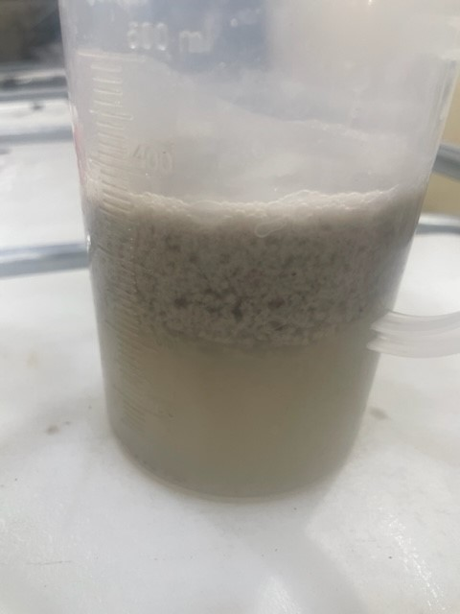
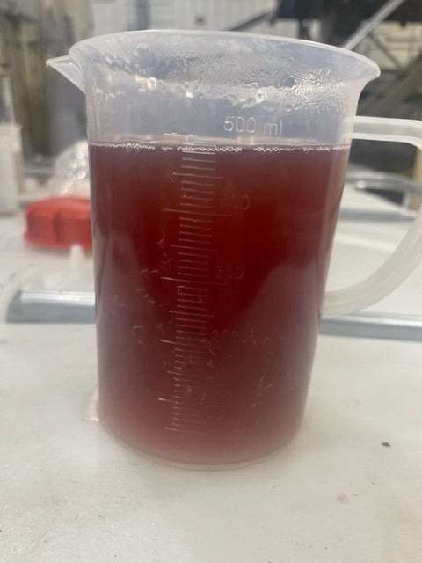
Three Phase Separation of DAF… Turning DAF waste and cost into a value stream as a sellable product
DAF
WASTE
VALUE
PRODUCT

Slide 5
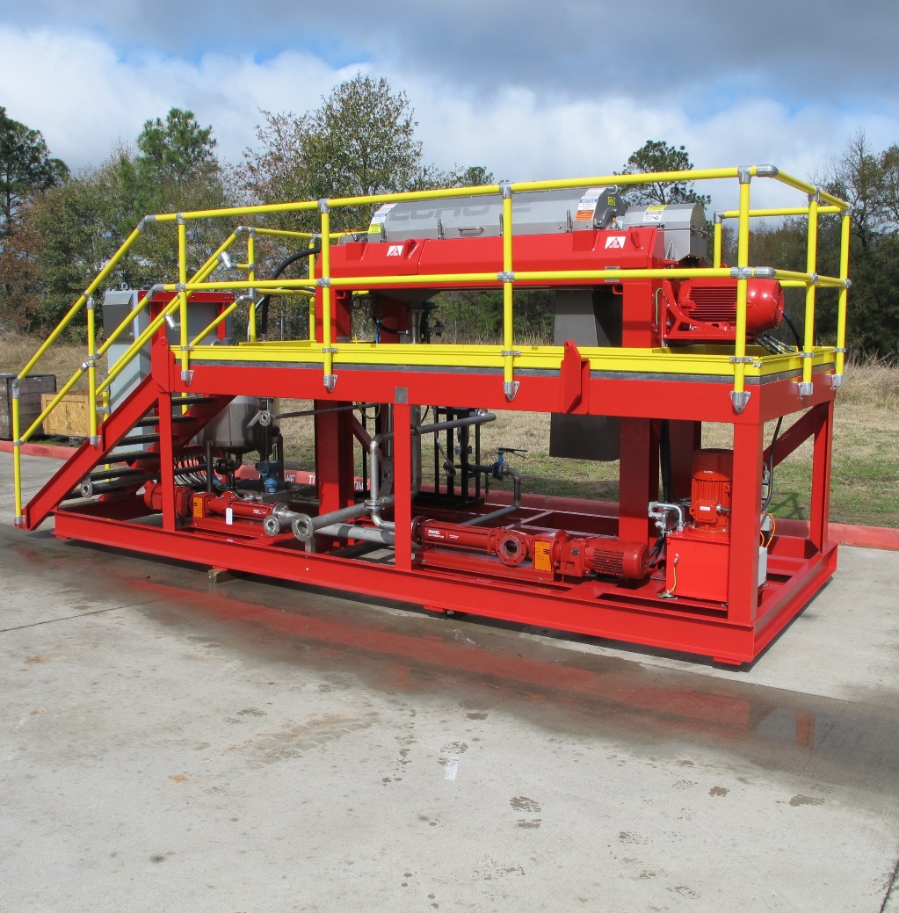
GTech’s Innovative Turnkey Solution Benefits
Ease of installation
Compact footprint
Fully automated control system
Maximized up time and yield
On the fly adjustment of oil paring pump to compensate the variability of daf skim

Slide 6
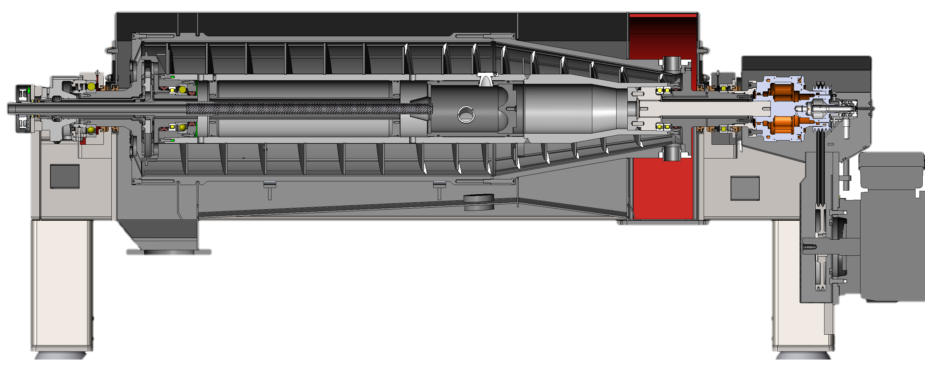
Product Inlet
Light Phase Outlet
Heavy Phase Outlet
Solids Outlet

Slide 7
Benefits of GTech’s 3 Phase Technology
Designed and Made in Australia, NZ, and USA
Low Total Cost of Ownership
Automation allows for Ease of Operation

Slide 8
Precise. Accurate. Autonomous.
Bowl diameter: 550mm (21.7”)
Bowl Length: 2200mm (86.6”)
Maximum Bowl Speed: 3400 RPM
Max G-Force: 3550 G
Light Phase Discharge: Electronically Actuated Paring Pump
Heavy Phase Discharge: Eccentric Dam Plates

Slide 9
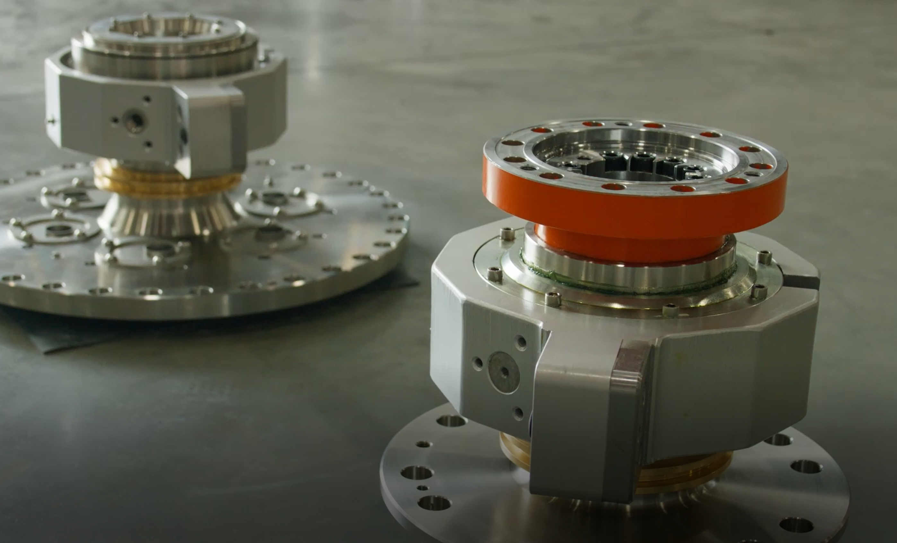
Hard working separation technology.
Duplex 2205 bowl
Tungsten Carbide solids discharge ports
Light phase discharged under pressure
Replaceable feedzone
Spring assisted lid for ease of maintenance

Slide 10
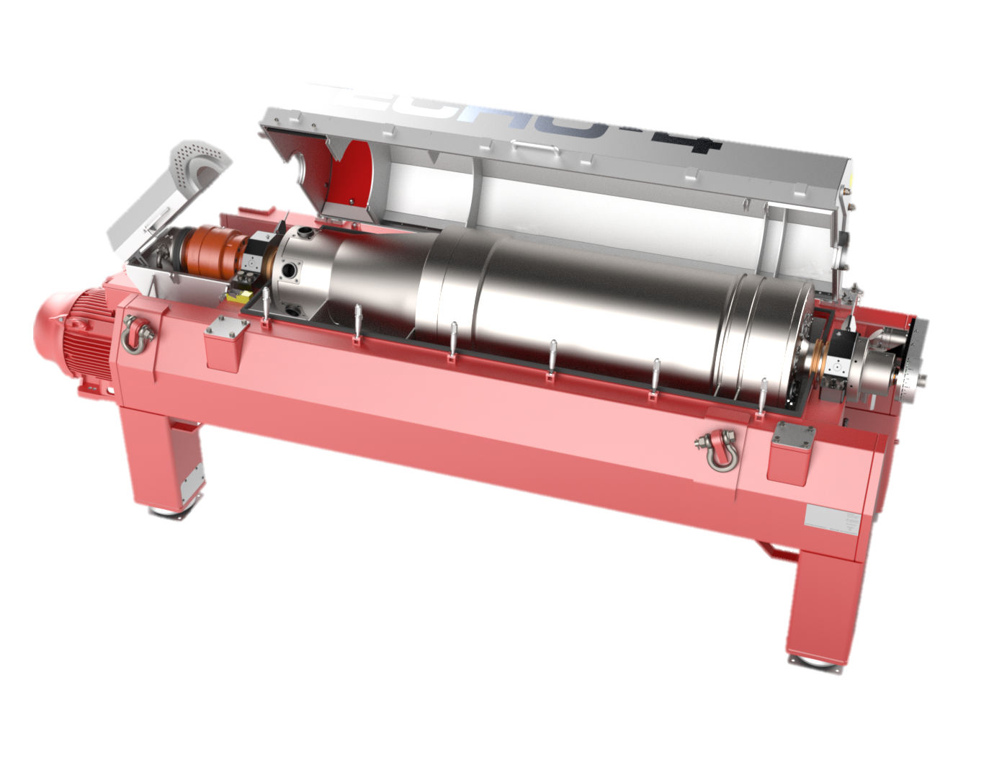
60HP (45kW) Bowl drive motor
40HP (30kW) Back drive Rotodiff – Torque regulated for consistent solids production
Sigma Max: 5860$m^{2}$ (63,077ft ${ft}^{2}$)
Max differential Speed: 30rpm

Slide 11
Global Innovative Quality Solutions
Questions
And
Answers
Come visit us as Booth 33

